Slide 1

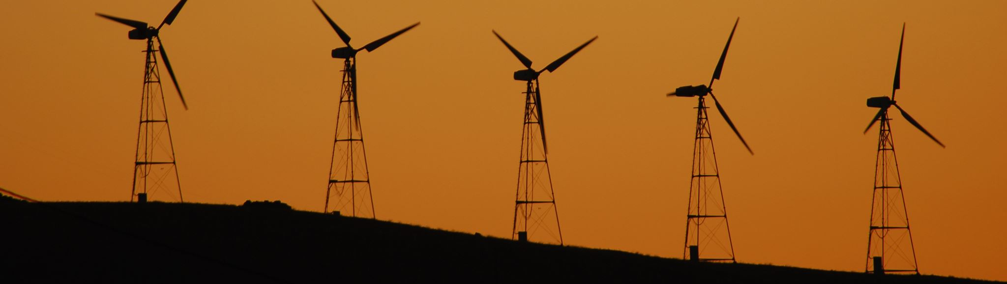
Clean Energy Production and Invesment

Slide 2
Table of Contents
- Project Background
- Production Data EDA
- Investment Data EDA
- Production vs Investment Analysis
- Takeaways

Slide 3
Project Background
What is the production trend in Clean Energy?
How are different forms of Clean Energy being used?
What is the USDA's investment into Clean Energy?
How does Clean Energy production compare to investment?
Which states have higher levels of investment?
How do Clean Energy production and investment compare by state on a per capita basis?

Slide 4
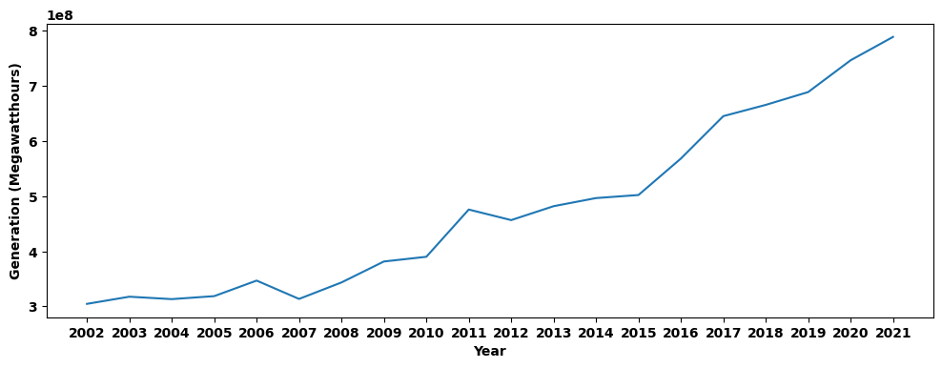
Production Data EDA
There has been a steady rise in the production of clean energy over the past 20 years

Slide 5
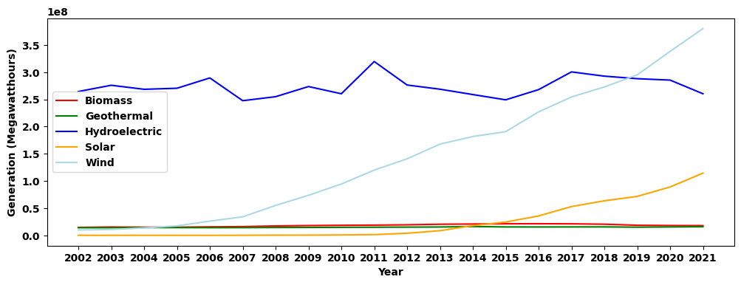
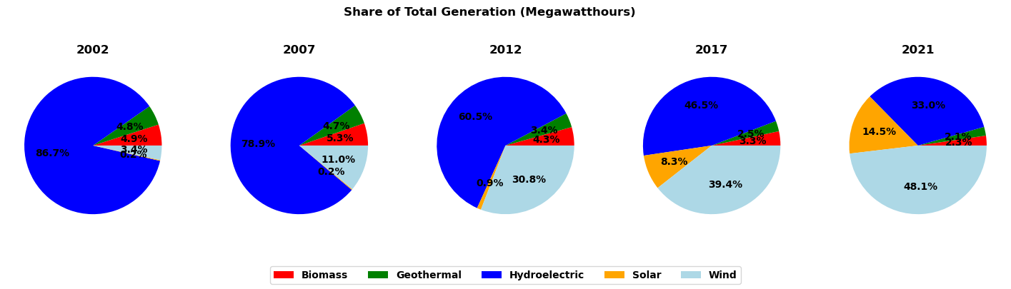
Production Data EDA
While Hydroelectric, Geothermal, and Biomass production has been relatively unchanged, there has been a massive increase in the use of Solar and Wind

Slide 6
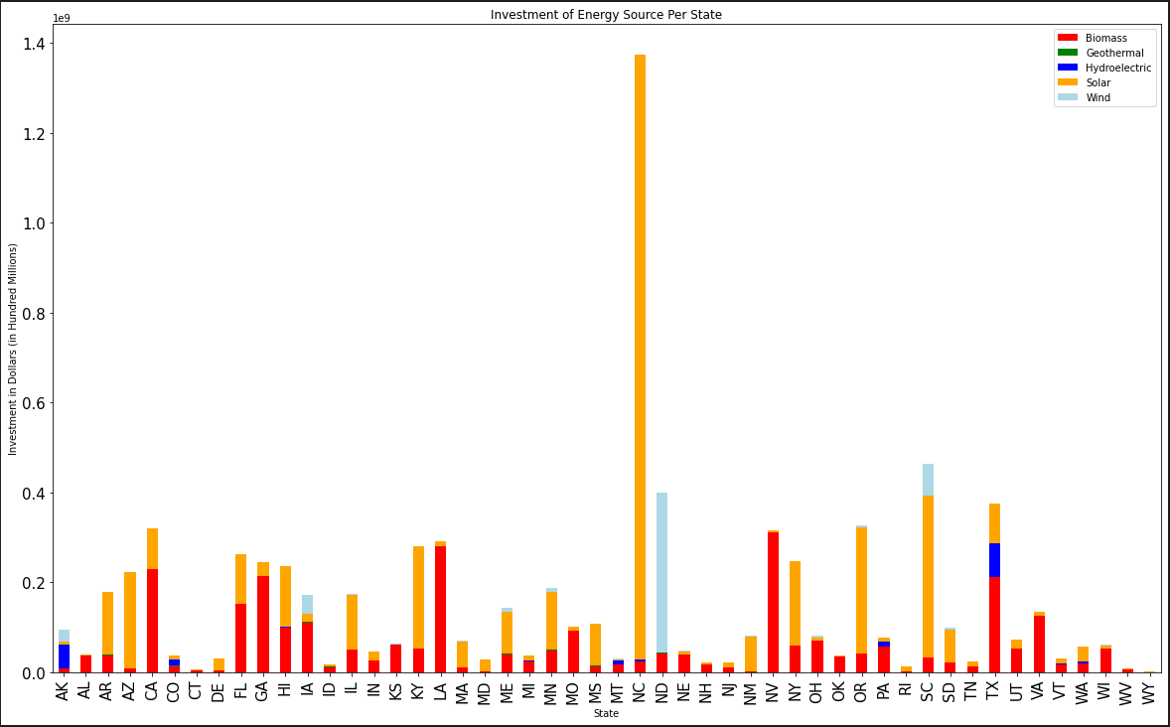
Investment Data EDA
Solar accounts for the greatest portion of investment, with large differences in total investment among states

Slide 7
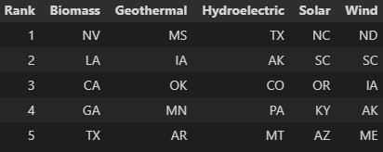
Top investment State per Clean Energy

Slide 8
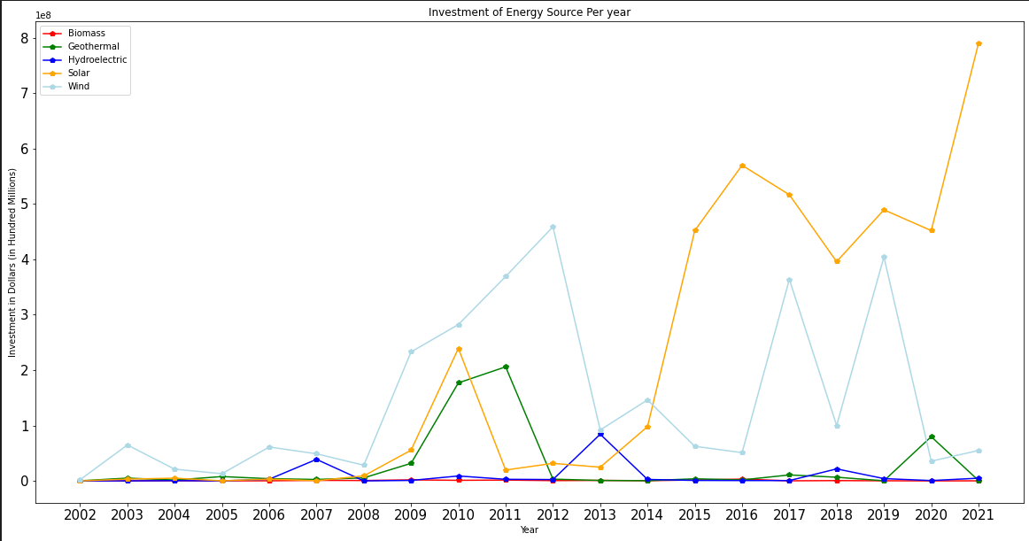
Investment of Clean Energy per Year

Slide 9
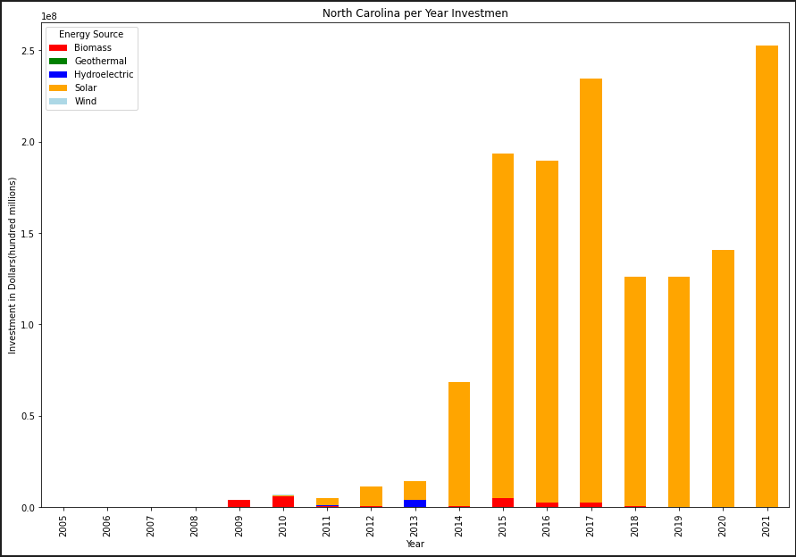
Outlier of Investment

Slide 10
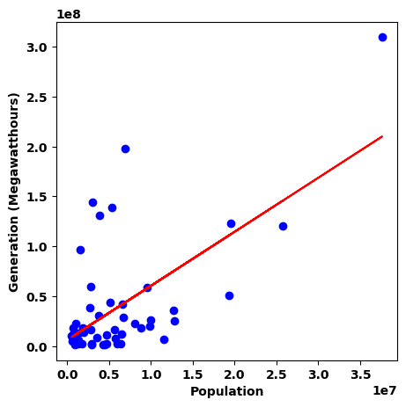
Production vs Investment Analysis
As expected, there is a strong positive correlation between State Population and Production, yet there are many outliers

Slide 11
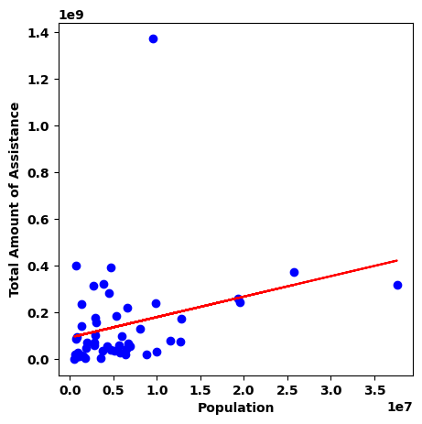
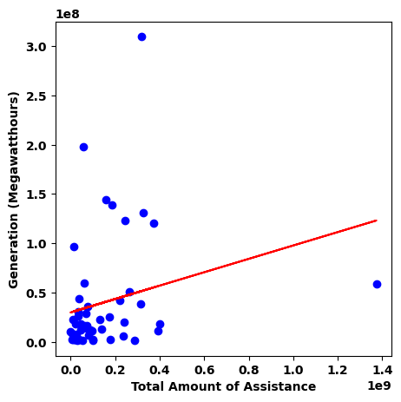
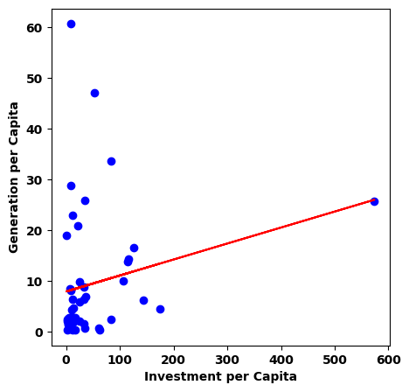
Production vs Investment Analysis
There are weak correlations between both State Population and Investment and Investment and Production, again with many outliers

Slide 12
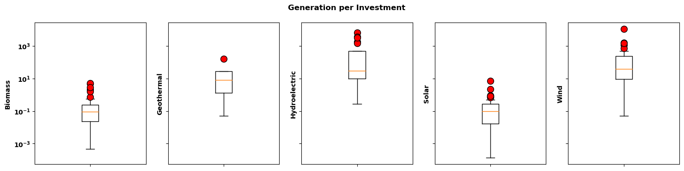
Production vs Investment Analysis
Hydroelectric and Wind show the best Generation per Investment, whereas Biomass and Solar show the lowest

Slide 13
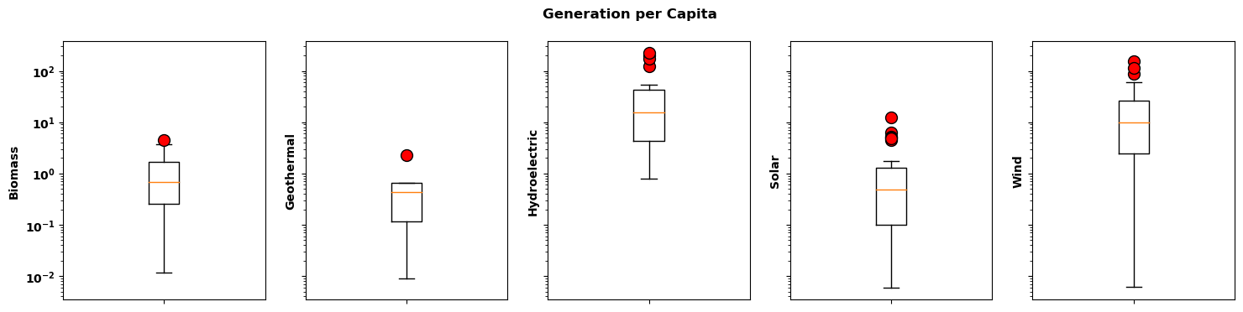
Production vs Investment Analysis
Hydroelectric and Wind also show the best Generation per Capita

Slide 14
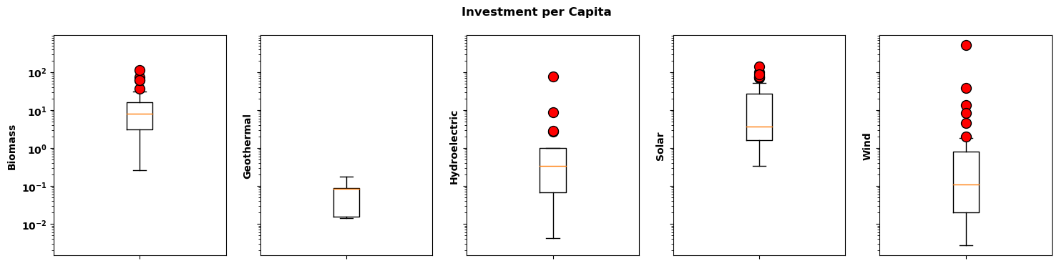
Production vs Investment Analysis
The Investment per Capita for Hydroelectric and Wind are relatively low, perhaps due to their efficiency

Slide 15
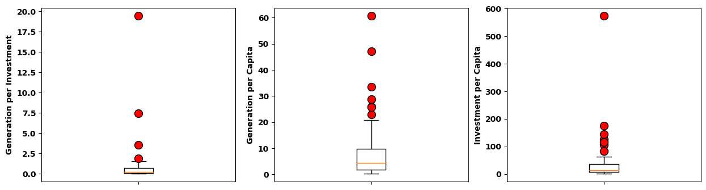
Production vs Investment Analysis
WY: 98.1%
ID: 93.7%
IA: 98.9%
OR: 94.9%
WA: 99.8%
MN: 85.8%
ID: 93.7%
MT: 99.6%
ND: 99.9%
WA: 99.8%
MT: 99.6%
*Outlier states labeled with their % production from hydroelectric + wind
The most extreme (high) levels of Generation per Investment and Generation per Capita are among states with high proportions of Hydroelectric and Wind usage. The Investment per Capita is very skewed and needs further investigation

Slide 16
Production vs Investment Analysis
Additional considerations for analysis of investment:
- Reliance on non-renewable energy sources, ie. fossil fuel, coal, etc
- Geographic layout, available land/resources
- Favorable conditions: wind, sun exposure, topography
- Political ambitions
- Energy produced but exported – shift of investment from consumers to producers

Slide 17
Takeaways
Clean energy production has increased across all states, with hydroelectric historically being the greatest source.
However, wind and solar have been growing rapidly, particularly in the past decade.
Investments in solar and wind are increasing, accounting for a vast majority of USDA investment in 2021.
Hydroelectric and Wind show the greatest Generation per Investment and Generation per Capita (while Biomass and Solar show the lowest)

